Slide 1


Get Pumped Up for Success!
Grades 3–5

Slide 2





What We Will Cover
Things to Know
Tips
What to Expect
Let’s Remember
Introduction Videos

Slide 3

“Why are we taking the
i-Ready Diagnostic?”

Slide 4
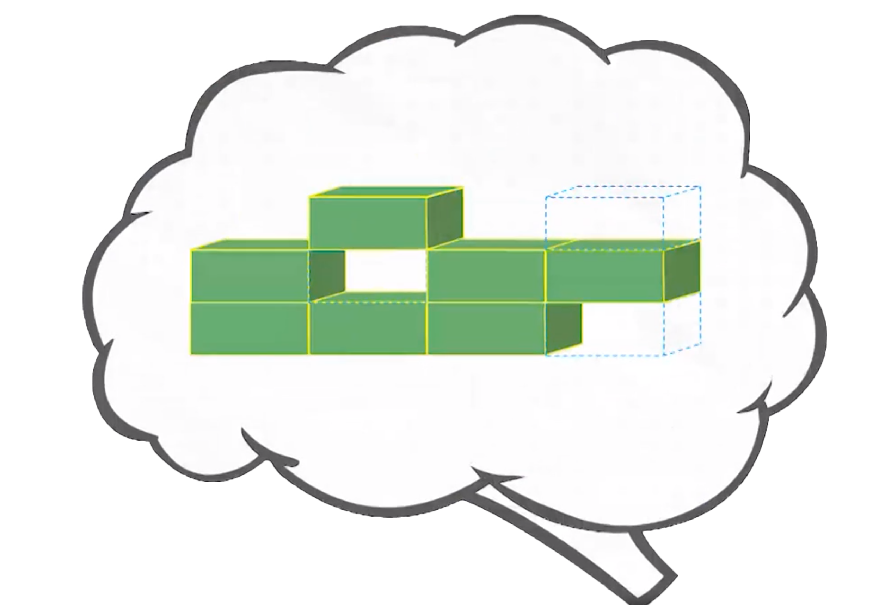
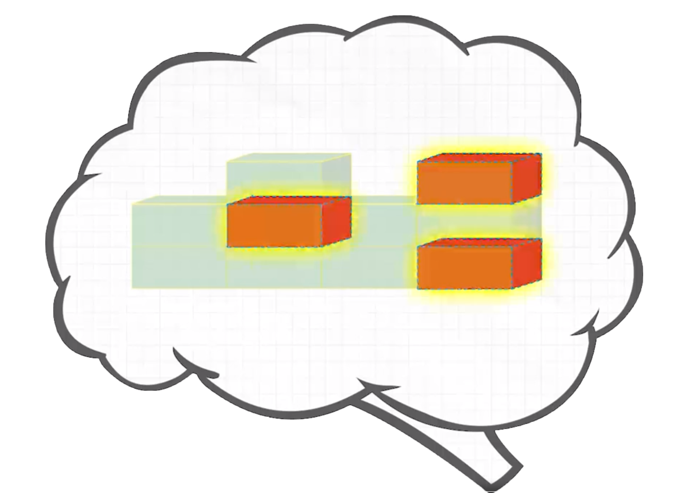
Remember, the Diagnostic Is Important Because It Helps You
and Your Teachers . . .
Understand what you
already know
and what you
need to learn
Notes:
Today, when you complete your Diagnostic, you will see a score pop up on your screen. This score is one of many that you will see on your Diagnostic report. Your Diagnostic report will help us see the areas where you have strengths and the areas where we can help you grow. We will talk about your Diagnostic report and your personal learning goals when we meet for our data chat.

Slide 5
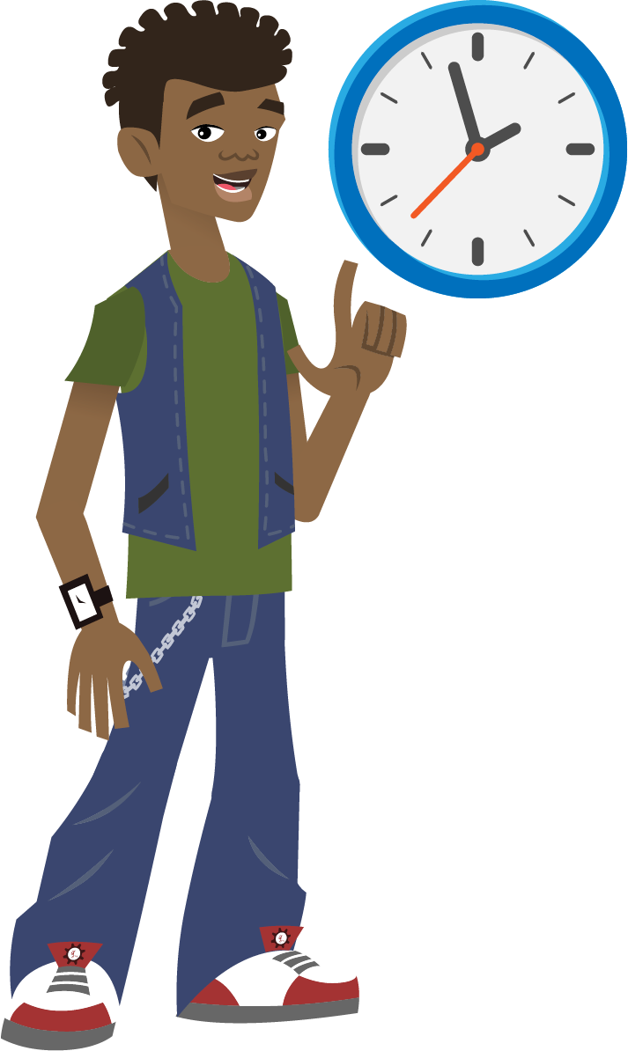
Remember, the Diagnostic Is Important Because It Helps You
and Your Teachers . . .
Make the best use of your learning time
Notes:
Today, when you complete your Diagnostic, you will see a score pop up on your screen. This score is one of many that you will see on your Diagnostic report. Your Diagnostic report will help us see the areas where you have strengths and the areas where we can help you grow. We will talk about your Diagnostic report and your personal learning goals when we meet for our data chat.

Slide 6

Remember, the Diagnostic Is Important Because It Helps You
and Your Teachers . . .
  Show what you know!
  Try your best so you can show what you’ve learned.
Notes:
Today, when you complete your Diagnostic, you will see a score pop up on your screen. This score is one of many that you will see on your Diagnostic report. Your Diagnostic report will help us see the areas where you have strengths and the areas where we can help you grow. We will talk about your Diagnostic report and your personal learning goals when we meet for our data chat.

Slide 7
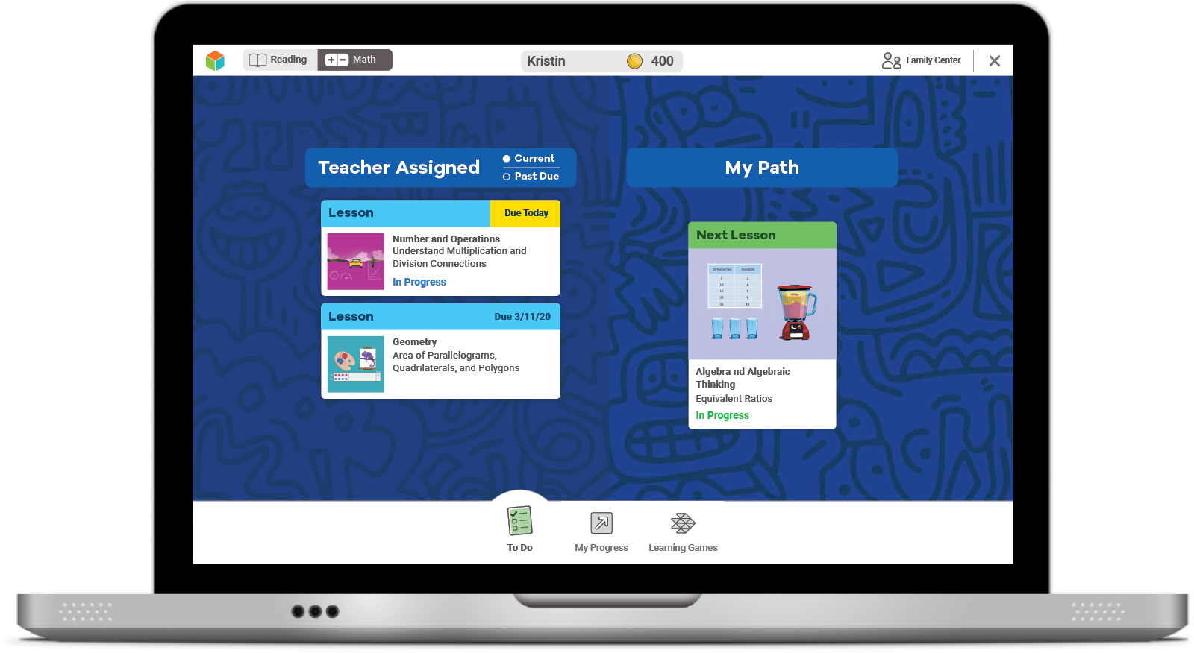
Online Lessons
If you try your best on the Diagnostic,
lessons will match what you need to learn.
The results of your Diagnostic decide
what lessons you will get.

Slide 8



How does the Diagnostic work?
i-Ready is an adaptive test. This means the questions change based on your answers.
Some questions will be . . .
Hard
Easy
Just Right!

Slide 9

Why is the Diagnostic really important now?
This past spring, you were learning from home.
Doing your best on the Diagnostic now will help you and your teacher know what you learned while you were at home and what you are ready to learn.

Slide 10

What should you do?
Remember this test is adaptive! You should try your best, but know that you’ll get questions you don’t know how to answer.

Slide 11
What should you do?
Try your best.
Do not rush, but do not spend too much time on any one question.

Slide 12



What should you do?
You will see questions you won’t know how to answer because you haven’t learned them yet.
That is okay! Choose the best answer and move on.
Too Hard
Too Easy
Just Right

Slide 13
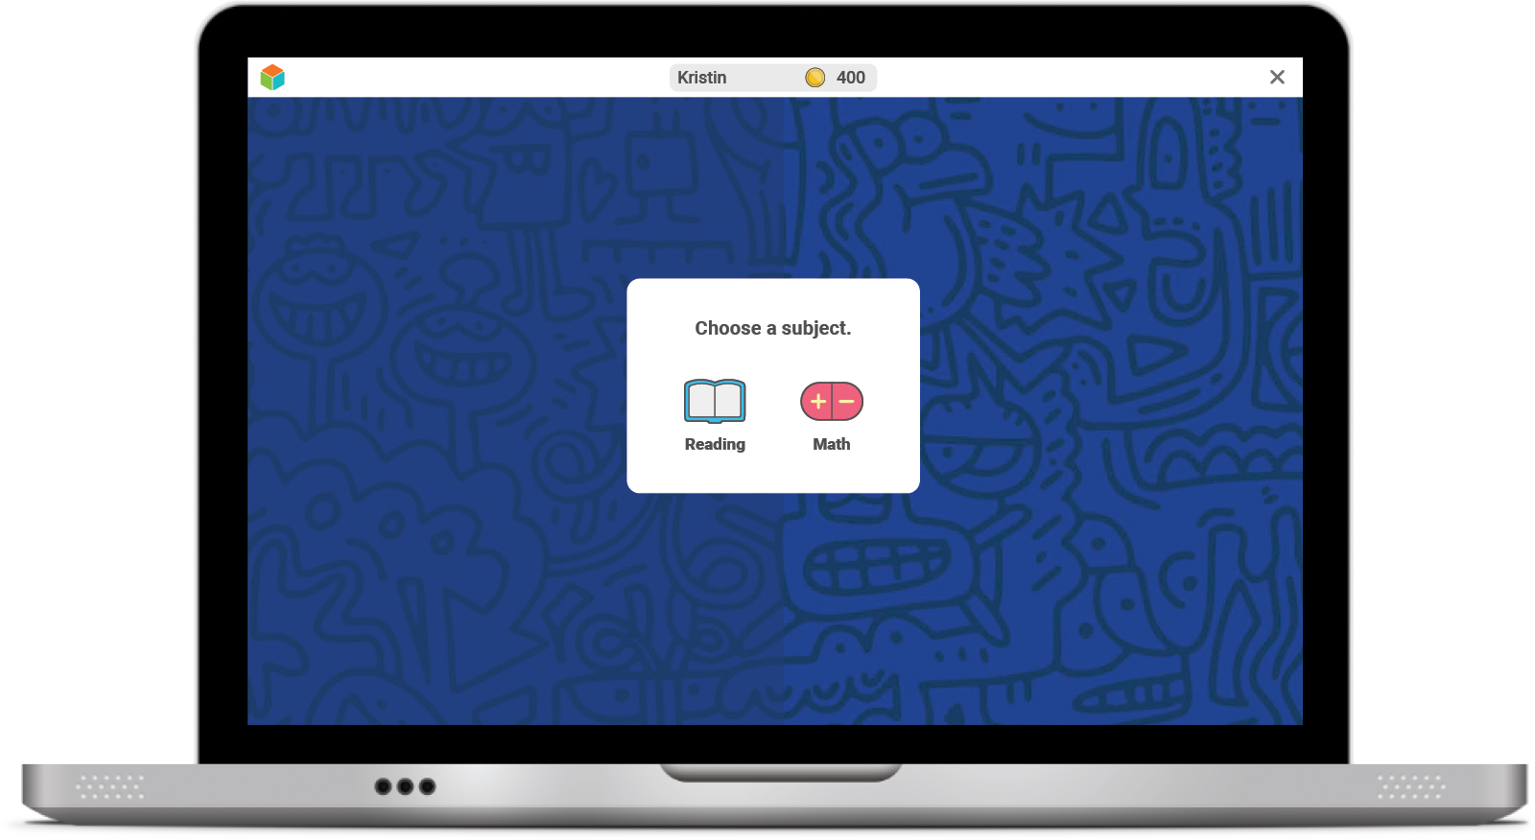
Once you log in, you will see this:

Slide 14
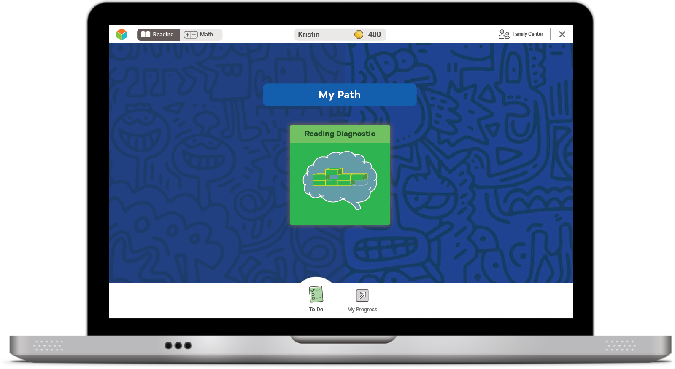
Next, you will see a page like this:
Select the green button
to start your Diagnostic.

Slide 15
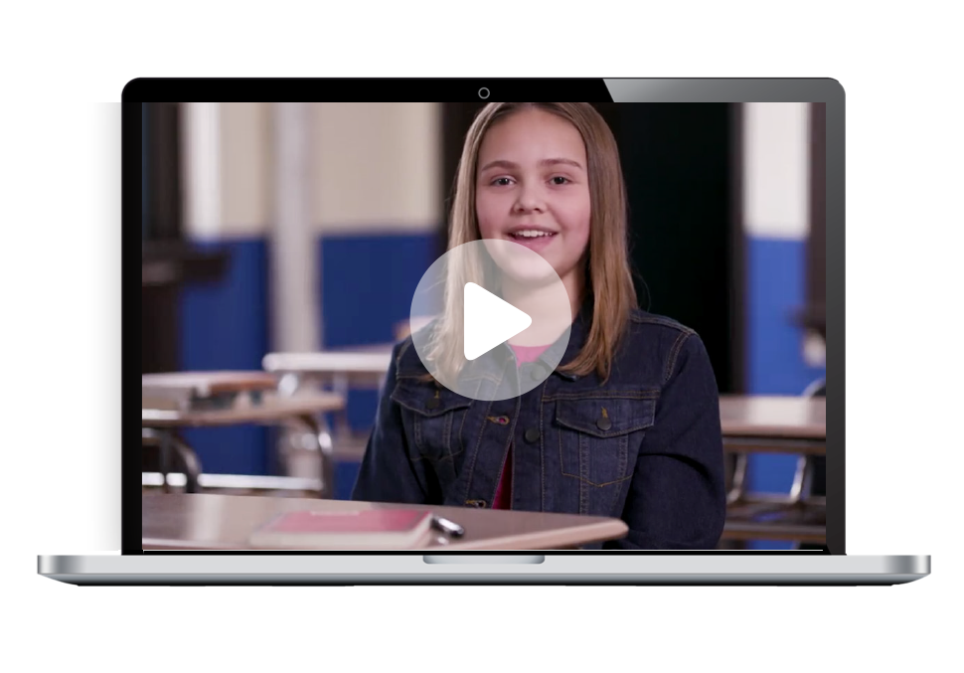
Next, you will:
Watch a video.

Slide 16
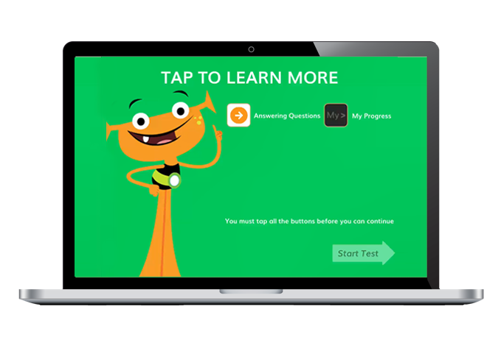
Next, you will:
Watch a video.
Click on each button
to watch a video
about each tool.

Slide 17
Next, you will:
Watch a video.
You must click on all of them before you can press start.

Slide 18
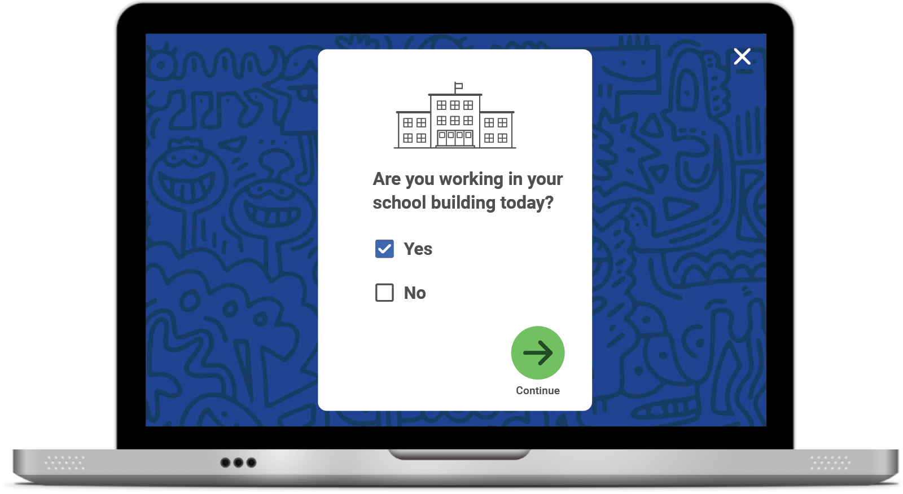
Student Survey
Once you START or RESUME your Diagnostic, you will see this question pop up on your screen:
Click No if you are taking the Diagnostic at HOME.
Click YES if you are taking the Diagnostic at SCHOOL.
Click the green arrow to move on.

Slide 19


Optional
Introductory Demo Videos
You will get to try this on your own!
MATH
READING

Slide 20






Helpful Tips
Take your time and do not rush.
Read each question and answer choice carefully.
If you get a question you have not learned yet, try your best. Like school, your teacher and family cannot help!
For Math—Show your work on paper for every problem.
For Reading—Read each passage carefully, and
reread the passage when necessary.
Check your work before going to the next question.

Slide 21
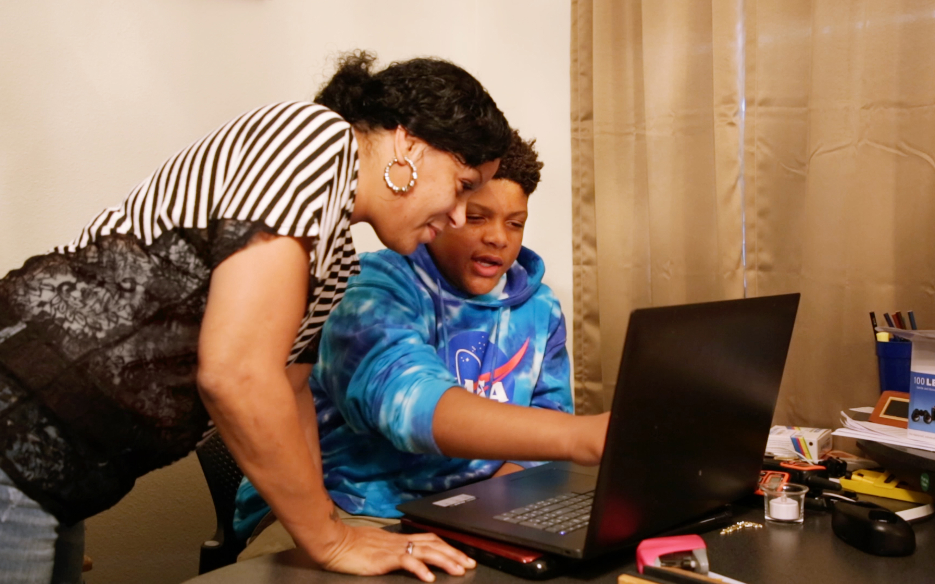
Our Plan
After the Diagnostic, i-Ready creates a special report for you and your family.

Slide 22
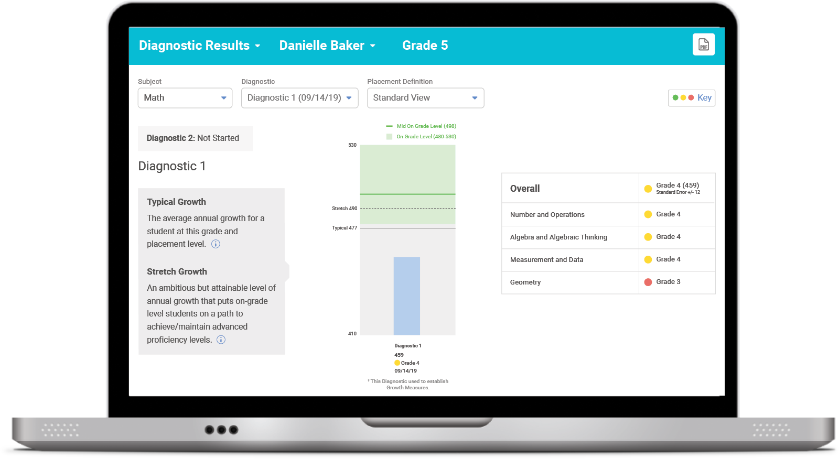
Our Plan
We can talk about:
How you did
What your growth goals are
Your strengths and areas for growth
After the Diagnostic, we can
review your results and goals.

Slide 23
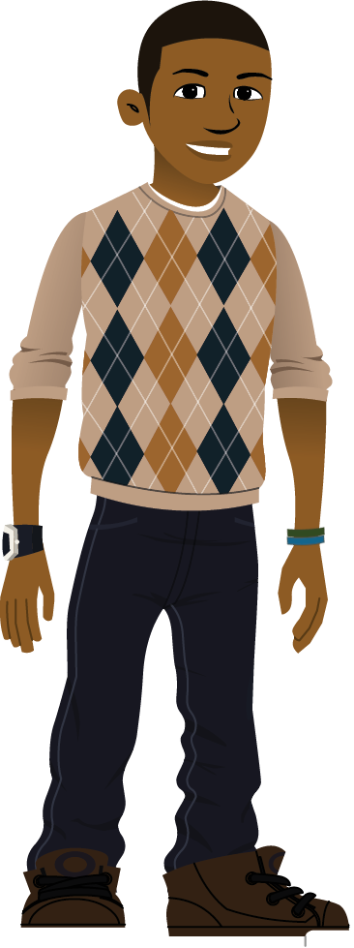
Optional
Our Incentives
Class incentives
Individual incentives
Optional
Notes:
For ideas from other educators, visit i-ReadyCentral.com/Ideas.

Slide 24

Reflections
What strategies do you plan to use on your i-Ready Diagnostic?
What do you want to remember?

Slide 25
Embedded Universal Supports
Grades K–8

Slide 26
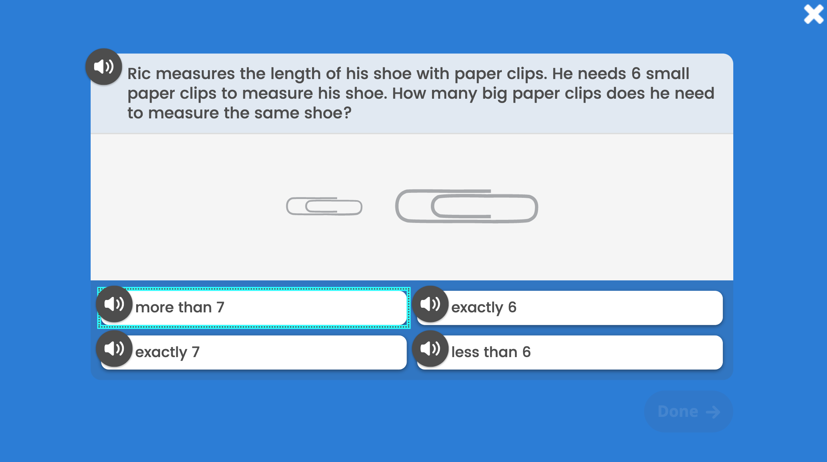
Keyboard Navigation
How: Using specific keyboard selections:
Tab, Shift + Tab, and Enter or Space
A box will appear showing
where you are on the screen.
The Tab key
will initiate keyboard navigation features.

Slide 27
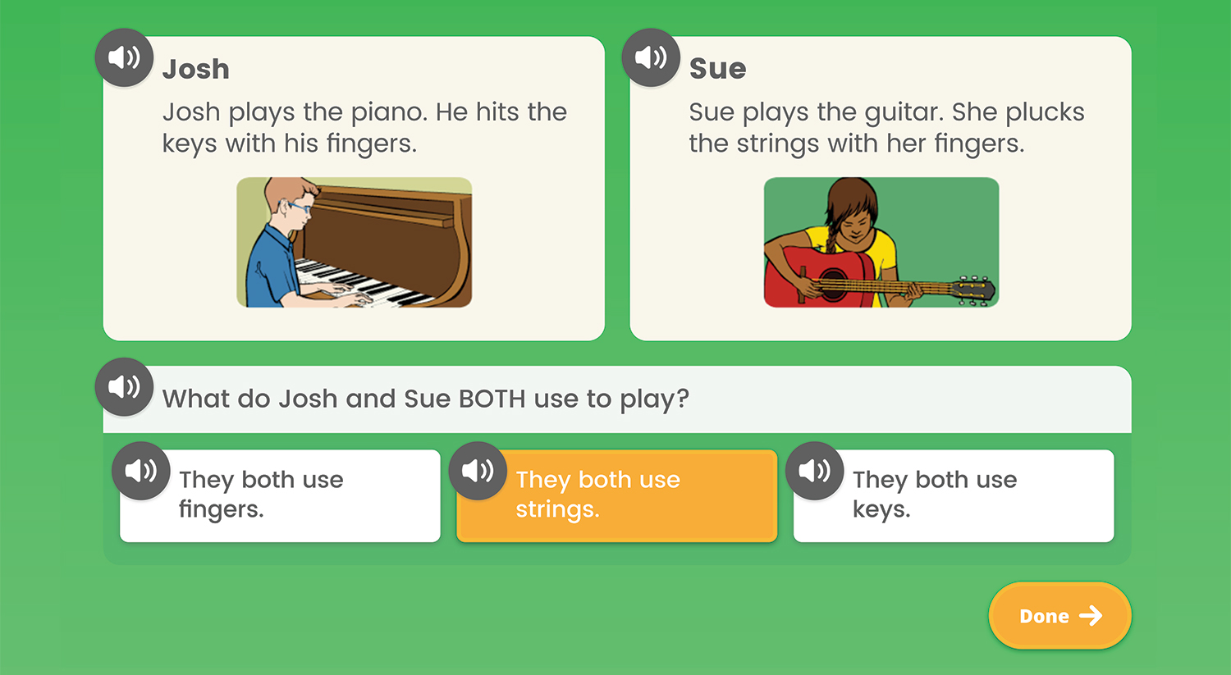
Audio Support
How: Using the speaker icon,
wherever it appears
Notes:
Audio support is currently available for Diagnostic items at these levels:
Mathematics: Grades K–5
Phonics: Grades K–3
High-Frequency Words: Grades K–3
Vocabulary: Grades K–2
Phonological Awareness: Grades K–1
Reading Comprehension: Grade K
What: Provides the ability to click on an audio button (speaker icon) to have the corresponding text for a question and/or answer read aloud
Where: For select items in the Diagnostic, based on the domain and/or level of the items

Slide 28
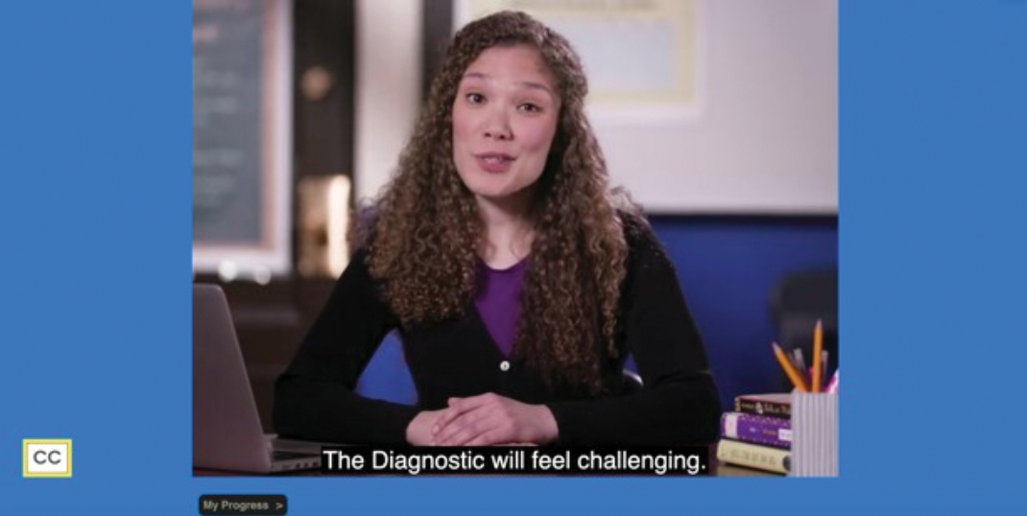
Closed Captioning
How: Using the CC box in the bottom left corner of the screen
Clicking the CC box allows you to view the text on screen.
Notes:
What: Provides the ability to display text on the computer screen that aligns to the audio
Where: In Diagnostic Introductory Videos for Grades 3+ when viewed through the student-facing Diagnostic assessment screen. Closed captioning is not available for test items at this time.

